Slide 1
Semester: UG 1ST
CORE Paper- I : Understanding Political Theory
Unit: II
Topic Name: Theories of Feminism: An Introduction
Presented By
Prof. Gyanaranjan Swain

Slide 2
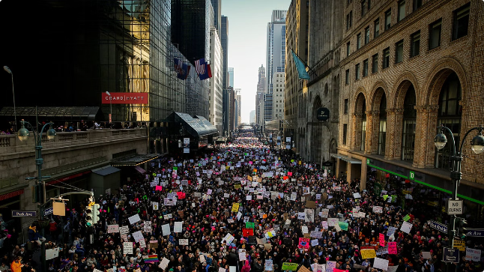
Theories of Feminism: An Introduction
Feminism is a diverse and multifaceted movement that challenges traditional gender roles and advocates for the rights and equality of women. There are several key theories within feminist thought, each with its own unique perspectives and goals.

Slide 3
Liberal Feminism
Core Beliefs
Key Figures
Limitations
Liberal feminists believe in achieving gender equality through legal and political reforms, such as equal rights, equal access to education and employment, and the elimination of discrimination.
Notable liberal feminist thinkers include Mary Wollstonecraft, Betty Friedan, and Gloria Steinem.
Liberal feminism has been criticized for its focus on individual rights rather than addressing systemic issues and intersectionality.

Slide 4
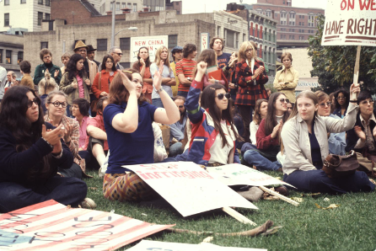
Radical Feminism
1
Analysis of Patriarchy
2
Focus on Women's Experiences
3
Transformative Change
Radical feminists view patriarchy as the root cause of women's oppression and seek to dismantle the entire patriarchal system.
Radical feminists advocate for revolutionary change, aiming to create a fundamentally different social and political structure.
Radical feminists emphasize the unique experiences and perspectives of women, rejecting the male-centric norms of society.

Slide 5
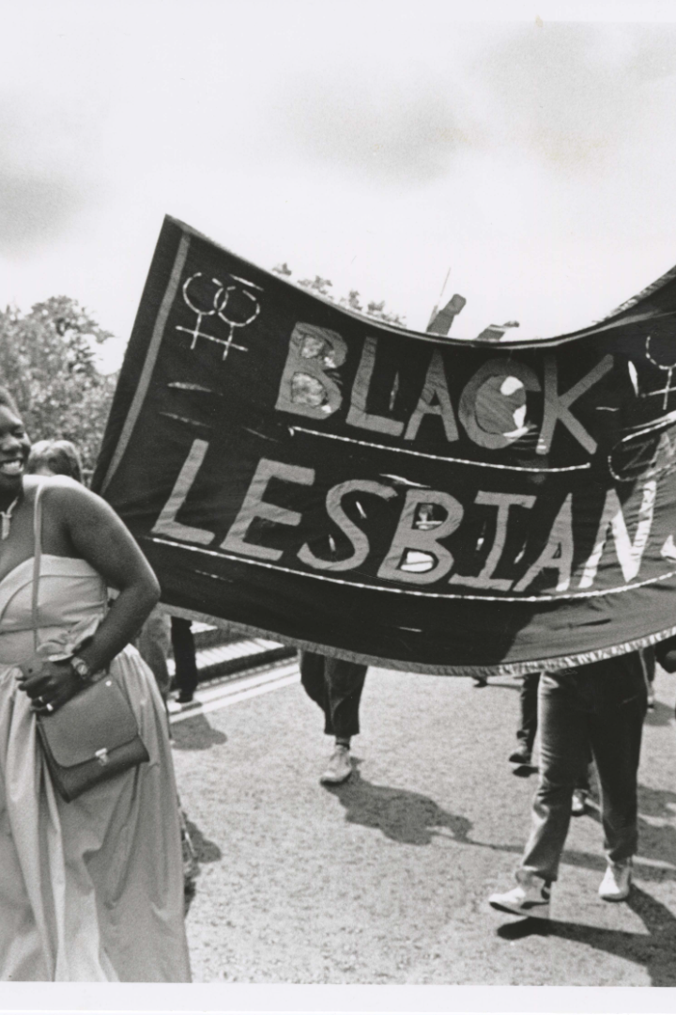
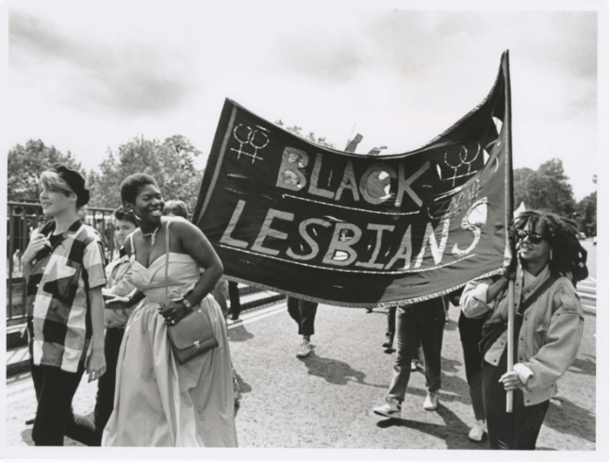
Marxist and Socialist Feminism
Class Analysis
Collective Struggle
Marxist and socialist feminists analyze the intersection of gender and class, viewing capitalism as a key driver of women's oppression.
These feminists advocate for a collective struggle against capitalism and patriarchy, emphasizing the need for economic and social transformation.
Labor and Reproduction
Marxist and socialist feminists focus on the exploitation of women's labor, both in the workforce and in domestic/reproductive work.

Slide 6
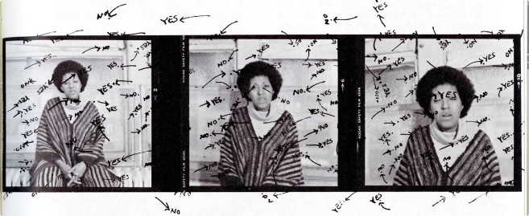
Postmodern Feminism
Deconstruction
Postmodern feminists challenge traditional notions of identity, power, and knowledge, using deconstruction to question dominant narratives.
Intersectionality
Postmodern feminism emphasizes the intersections of gender with other identity factors, such as race, class, sexuality, and disability.
Discourse Analysis
Postmodern feminists analyze the role of language and discourse in constructing and perpetuating gender norms and power structures.

Slide 7
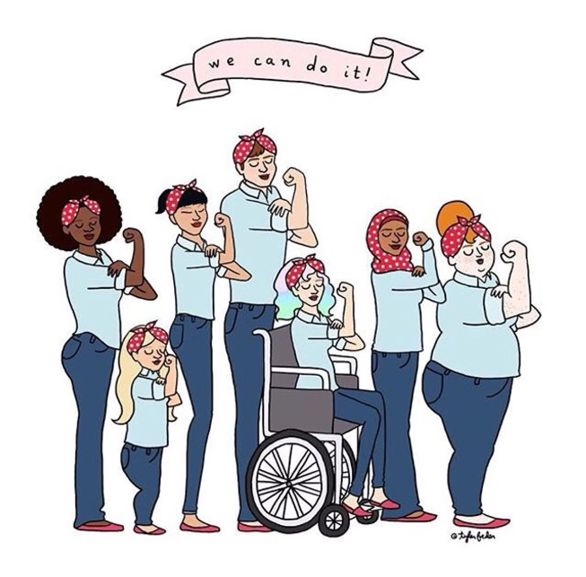
Intersectionality and Feminist Theory
1
Origins
The concept of intersectionality was first introduced by legal scholar Kimberlé Crenshaw in the late 1980s.
2
Theoretical Foundations
Intersectionality builds on the work of Black feminists, who recognized the need to address the unique experiences of women of color.
3
Contemporary Applications
Intersectionality has become a central tenet of modern feminist theory, informing activism and scholarship across various disciplines.

Slide 8
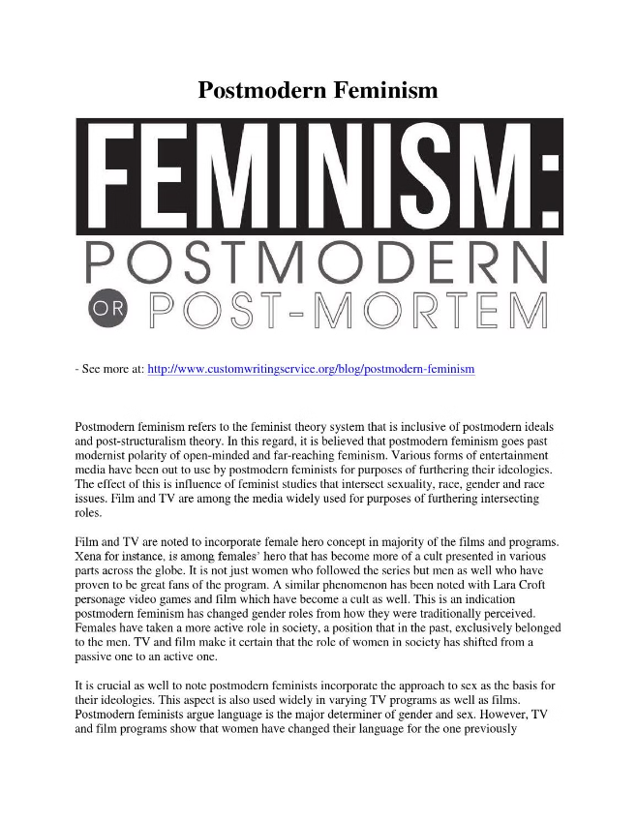
The Influence of Postmodernism on Feminist Thought
Destabilizing Gender Norms
Postmodern feminism challenges the idea of a fixed, stable gender identity, viewing gender as a performative and socially constructed phenomenon.
Questioning Universality
Postmodern feminists reject the notion of a universal, essentialist "woman" and instead focus on the diversity of women's experiences.
Embracing Multiplicity
Postmodern feminism celebrates the multiplicity of identities and perspectives, rejecting the idea of a singular feminist narrative.

Slide 9
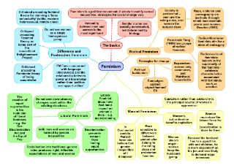
Challenges and Critiques of Feminist and Postmodern Theories
Criticism
Response
Lack of Unified Vision
Feminist and postmodern theories embrace diversity and acknowledge the complexity of gender and power relations.
Perceived Impracticality
Feminist and postmodern theories aim to challenge and transform existing structures, which may require significant social and political change.
Difficulty in Empirical Verification
Feminist and postmodern theories emphasize the importance of qualitative, interpretive, and contextual approaches to understanding gender and power dynamics.

